Slide 1
TRANSFORMATIONS OF OBJECTS
1

Slide 2
Transformation
Transformation is the application of some mathematical rules to an object or a pixel to bring about some change to it.
This change can be a displacement of an object from one point to another or a change in its size or shape.
Two types of transformations are
Solid body transformations
Affine transformations

Slide 3
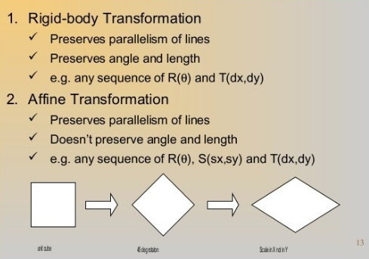

Slide 4
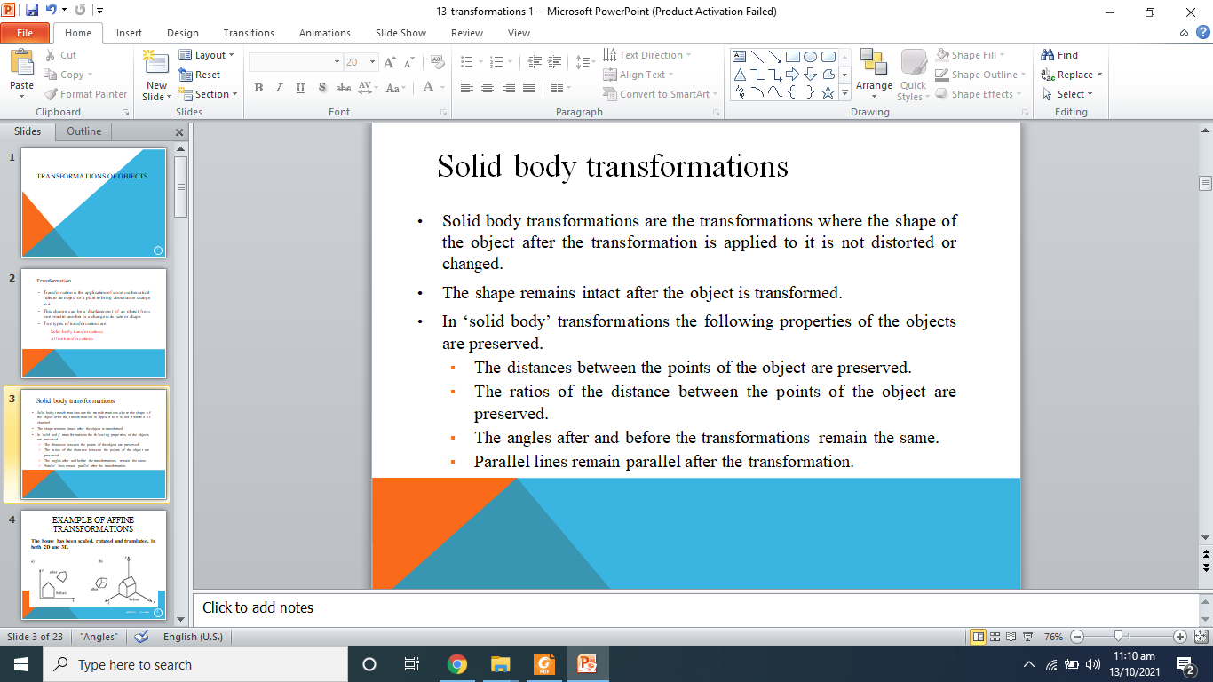
Solid body transformations
In Solid body transformations shape of the object after the transformation is applied to it is not distorted or changed.
The shape remains intact after the object is transformed.
In ‘solid body’ transformations the following properties of the objects are preserved.
The distances between the points of the object are preserved.
The ratios of the distance between the points of the object are preserved.
The angles after and before the transformations remain the same.
Parallel lines remain parallel after the transformation.

Slide 5
Affine transformations
Affine transformations are the transformations that change the shape of the object they are applied on but they do not distort the object.
Affine transformations have the following properties.
The distances between the points are not preserved.
The angles are not preserved.
The ratios of the distances between the points are preserved.
Parallel lines remain parallel after the transformations are applied.
Affine transformations include i) Scaling ii) Shear

Slide 6
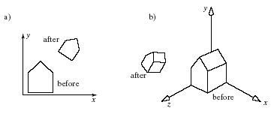
EXAMPLE OF TRANSFORMATIONS
The house has been scaled, rotated and translated, in both 2D and 3D.
6

Slide 7
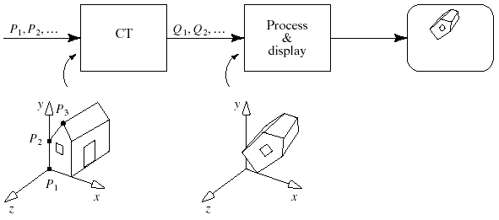
THE OPENGL GRAPHICS PIPELINE
This version is simplified.
7

Slide 8
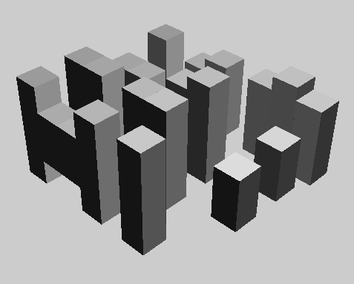
USING TRANSFORMATIONS (2)
In 3D, many cubes make a city.
8

Slide 9
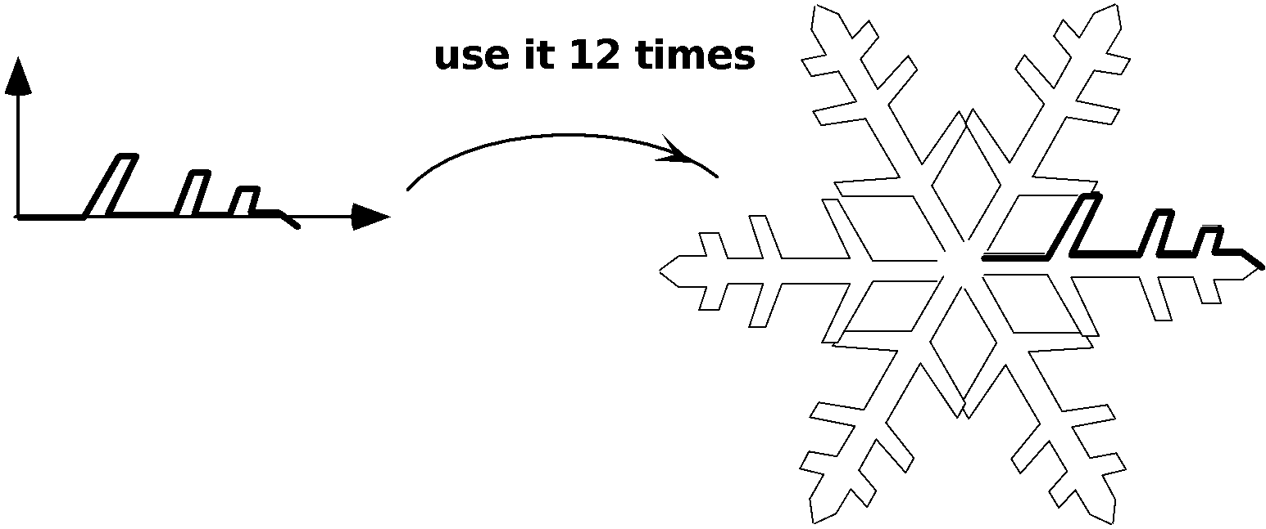
USING TRANSFORMATIONS (3)
The snowflake exhibits symmetries.
We design a single motif and draw the whole shape using appropriate reflections, rotations, and translations of the motif.
9

Slide 10
USING TRANSFORMATIONS (5)
In a computer animation, objects move.
We make them move by translating and rotating their local coordinate systems as the animation proceeds.
A number of graphics platforms, including OpenGL, provide a graphics pipeline: a sequence of operations which are applied to all points that are sent through it.
A drawing is produced by processing each point.
10

Slide 11
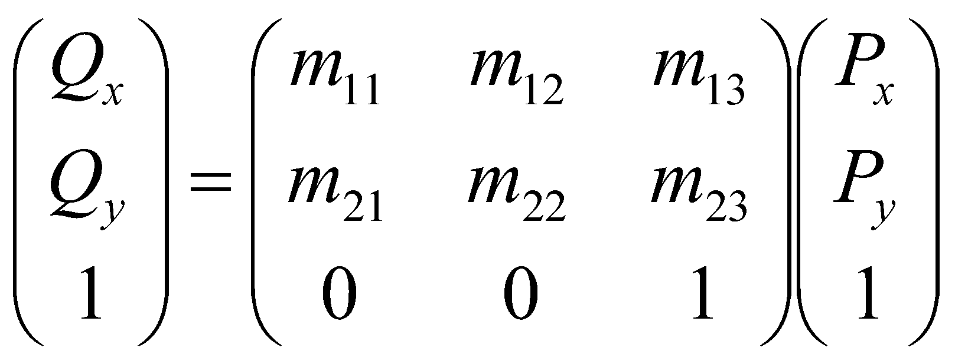
AFFINE TRANSFORMATIONS
Matrix form of the affine transformation in 2D:
For a 2D affine transformation the third row of the matrix is always (0, 0, 1).
11

Slide 12
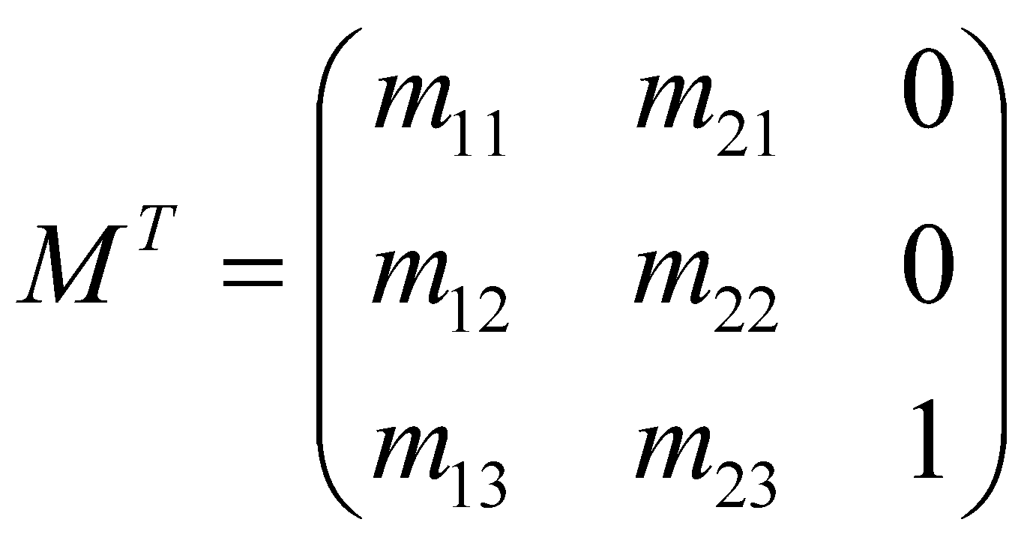
AFFINE TRANSFORMATIONS (5)
Some people prefer to use row matrices to represent points and vectors rather than column matrices: e.g., P = (P_{x}, P_{y}, 1)
In this case, the P vector must pre-multiply the matrix, and the transpose of the matrix must be used: Q = P M^{T}.
12

Slide 13
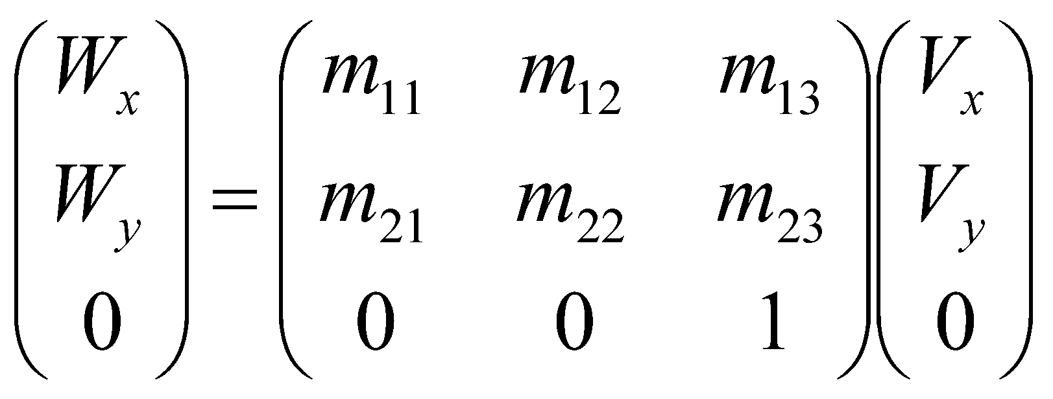
AFFINE TRANSFORMATIONS
When vector V is transformed by the same affine transformation as point P, the result is
Important: to transform a point P into a point Q, post-multiply M by P: Q = M P.
13

Slide 14
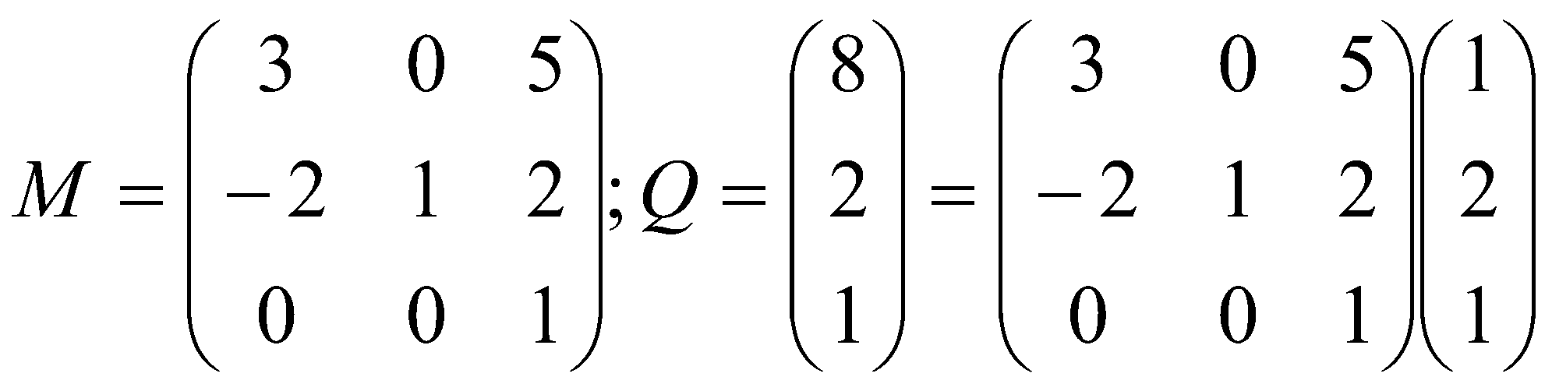
AFFINE TRANSFORMATIONS
Example: find the image Q of point P = (1, 2, 1) using the affine transformation
14

Slide 15
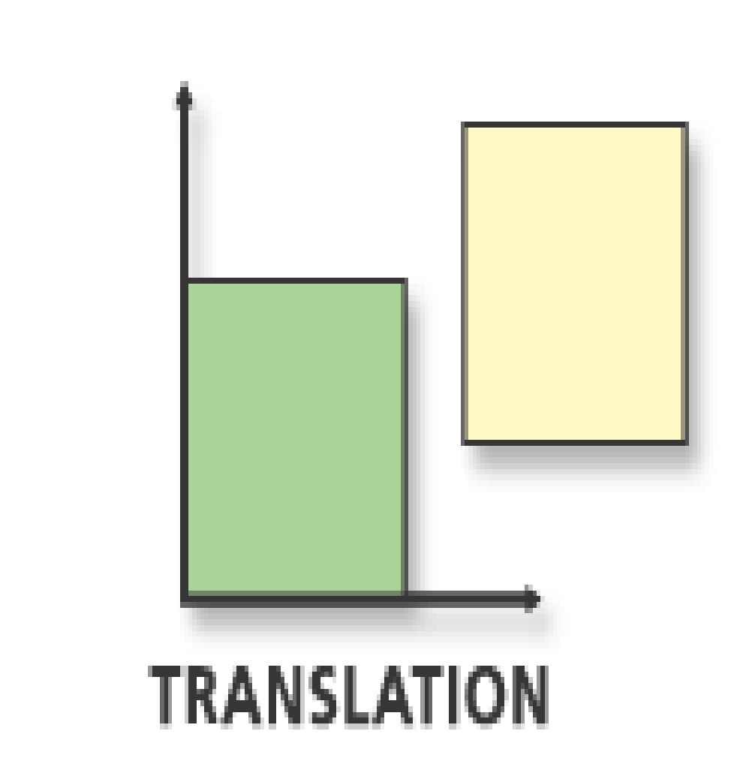
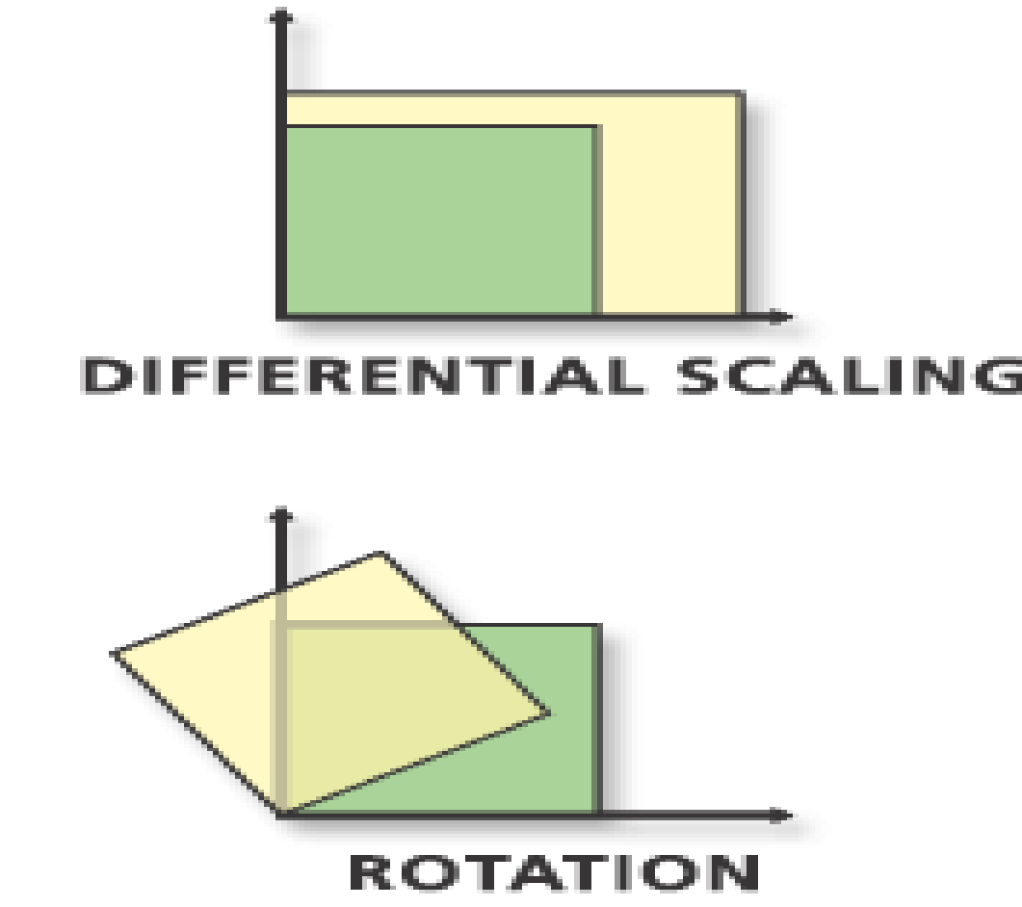
GEOMETRIC EFFECTS OF AFFINE TRANSFORMATIONS
Combinations of four elementary transformations: (a) a translation, (b) a scaling, (c) a rotation, and (d) a shear (all shown below).
15

Slide 16
TRANSLATIONS
The amount P is translated does not depend on P’s position.
It is meaningless to translate vectors.
To translate a point P by a in the x direction and b in the y direction use the matrix:
Only using homogeneous coordinates allow us to include translation as an affine transformation.
16

Slide 17
Translation of point:
To translate a point from coordinate position (x, y) to another (x, y), we add algebraically the translation distances Tx & Ty to the original co-ordinates.
Translation equation:
x1 = x + Tx y1 = y + Ty (The translation pair (Tx, Ty) is called as shift vector)
Example:
Given a square with coordinate points A (0, 3), B (3, 3), C (3, 0), D (0, 0). Apply the translation with distance 1 towards X axis and 1 towards Y axis. We have to find the new co-ordinates of the square.
Solution: Given-
Old co-ordinates of the square = A (0, 3), B (3, 3), C (3, 0), D (0, 0)
Translation vector = (Tx, Ty) = (1, 1)

Slide 18
For Coordinates A (0, 3)
Let the new coordinates of corner A = (X_{new}, Y_{new}).
Applying the translation equations, we have-
X_{new}= X_{old} + T_{x} = 0 + 1 = 1
Y_{new}= Y_{old} + T_{y} = 3 + 1 = 4
Thus, New coordinates of corner A = (1, 4).
For Coordinates B (3, 3)
Let the new coordinates of corner B = (X_{new}, Y_{new}).
Applying the translation equations, we have-
X_{new}= X_{old} + T_{x} = 3 + 1 = 4
Y_{new}= Y_{old} + T_{y} = 3 + 1 = 4
Thus, New coordinates of corner B = (4, 4).

Slide 19
For Coordinates C (3, 0)
Let the new coordinates of corner C = (X_{new}, Y_{new}).
Applying the translation equations, we have-
X_{new}= X_{old} + T_{x} = 3 + 1 = 4
Y_{new}= Y_{old} + T_{y} = 0 + 1 = 1
Thus, New coordinates of corner C = (4, 1).
For Coordinates D (0, 0)
Let the new coordinates of corner D = (X_{new}, Y_{new}).
Applying the translation equations, we have-
X_{new}= X_{old} + T_{x} = 0 + 1 = 1
Y_{new}= Y_{old} + T_{y} = 0 + 1 = 1
Thus, New coordinates of corner D = (1, 1).

Slide 20
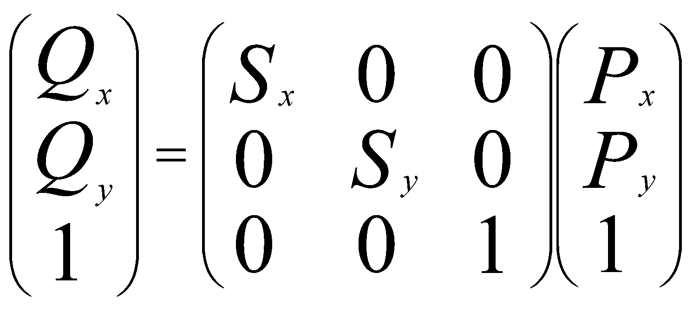
SCALING
Scaling is about the origin.
If S_{x} = S_{y} the scaling is uniform; otherwise it distorts the image.
If S_{x} or S_{y} < 0, the image is reflected across the x or y axis.
The matrix form is
20

Slide 21
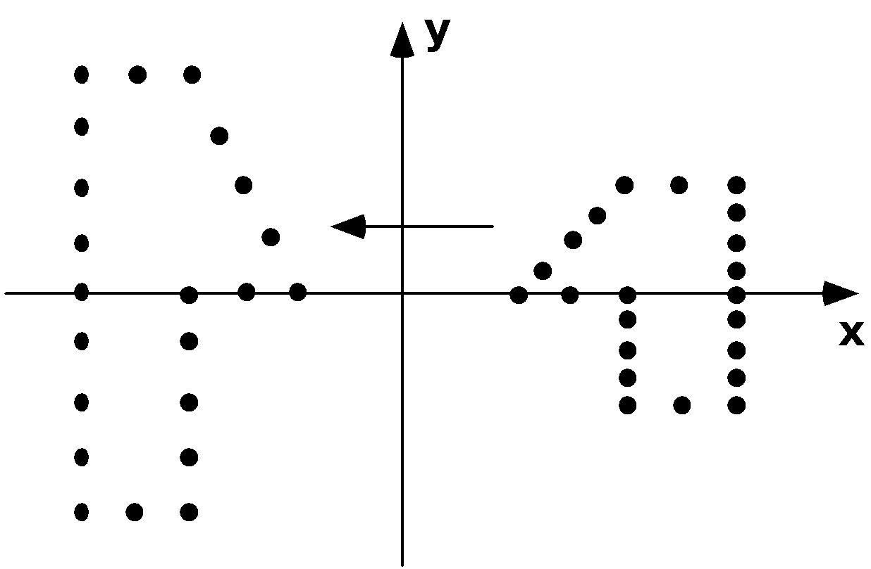
EXAMPLE OF SCALING
The scaling (Sx, Sy) = (-1, 2) is applied to a collection of points.
Each point is both reflected about the y-axis and scaled by 2 in the y-direction.
21

Slide 22
TYPES OF SCALING
Pure reflections, for which each of the scale factors is +1 or -1.
A uniform scaling, or a magnification about the origin: S_{x} = S_{y}, magnification |S|.
Reflection also occurs if S_{x} or S_{y} is negative.
If |S| < 1, the points will be moved closer to the origin, producing a reduced image.
If the scale factors are not the same, the scaling is called a differential scaling.
22

Slide 23
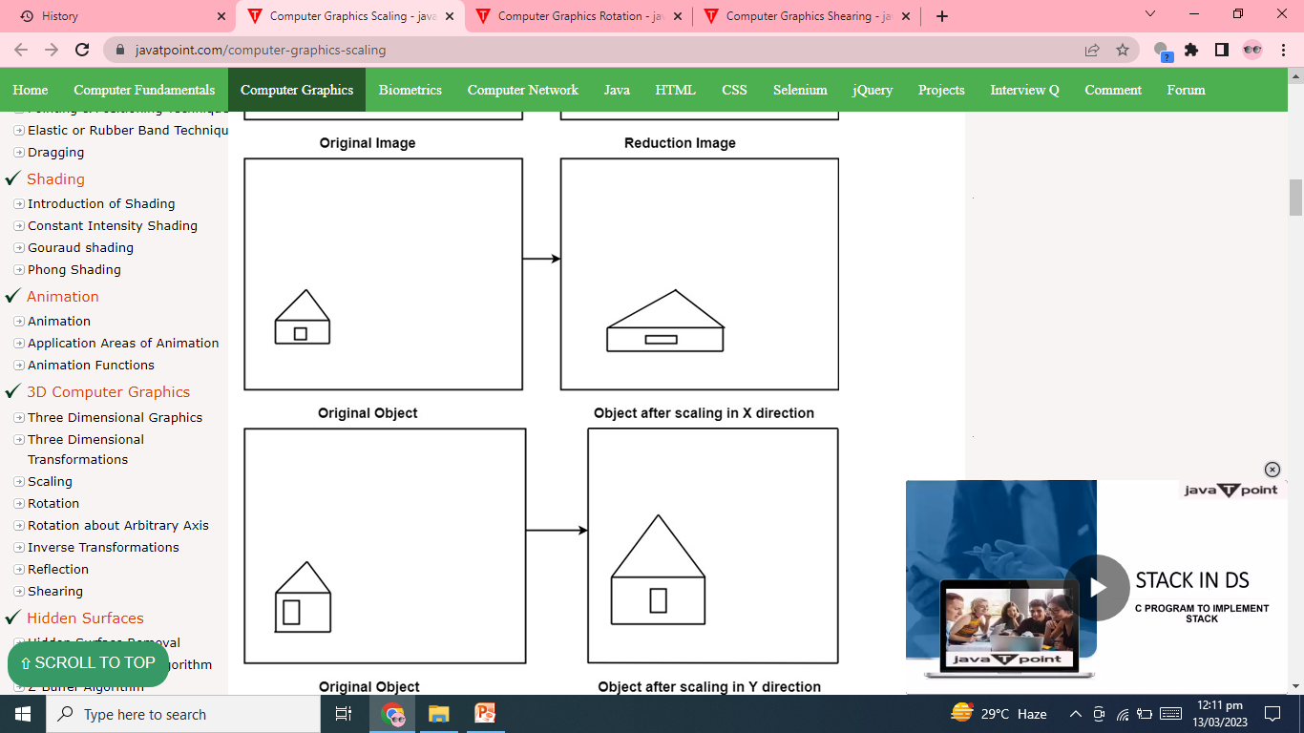

Slide 24
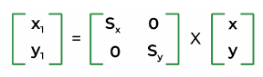
Formula for the Scaling:
Let us have object O on which we will perform the scaling.
initial coordinates of the object O = (x , y).
scaling factor in x-direction = S_{x}
scaling factor in y-direction = S_{y}
new coordinates after scaling = (x1, y1)
hence we have equations for scaling :
x1 = S_{x} * x
y1 = S_{y} * y
matrix representation

Slide 25
SCALE EXAMPLE:
Problem Statement: Given a square object with co-ordinate points A (0, 3), B (3, 3), C (3, 0), D (0, 0). Apply the scaling parameter 2 towards X axis and 3 towards Y axis and obtain the new co-ordinates of the object.
Solution:
Given,
Old corner coordinates of the square = A (0, 3), B (3, 3), C (3, 0), D (0, 0)
Scaling factor along X axis = 2
Scaling factor along Y axis = 3

Slide 26
For the Coordinate A (0, 3):
Let the new coordinates of corner A after scaling = (X_{new}, Y_{new}).
When we apply the scaling equation, we get,
X_{new} = X_{old} x S_{x} = 0 x 2 = 0 Y_{new} = Y_{old} x S_{y} = 3 x 3 = 9
Thus, the new coordinates of corner A after scaling = (0, 9).
For the Coordinate B (3, 3):
Let the new coordinates of corner B after scaling = (X_{new}, Y_{new}).
When we apply the scaling equation, we get-
X_{new} = X_{old} x S_{x} = 3 x 2 = 6 Y_{new} = Y_{old} x S_{y} = 3 x 3 = 9
Thus, the new coordinates of corner B after scaling = (6, 9).

Slide 27
For the Coordinate C (3, 0):
Let the new coordinates of corner C after scaling = (X_{new}, Y_{new}).
When we apply the scaling equation, we get-
X_{new} = X_{old} x S_{x} = 3 x 2 = 6 Y_{new} = Y_{old} x S_{y} = 0 x 3 = 0
Thus, the new coordinates of corner C after scaling = (6, 0).
For the Coordinate D (0, 0):
Let the new coordinates of corner D after scaling = (X_{new}, Y_{new}).
When we apply the scaling equation, we get-
X_{new} = X_{old} x S_{x} = 0 x 2 = 0 Y_{new} = Y_{old} x S_{y} = 0 x 3 = 0
Thus, the new coordinates of corner D after scaling = (0, 0).

Slide 28
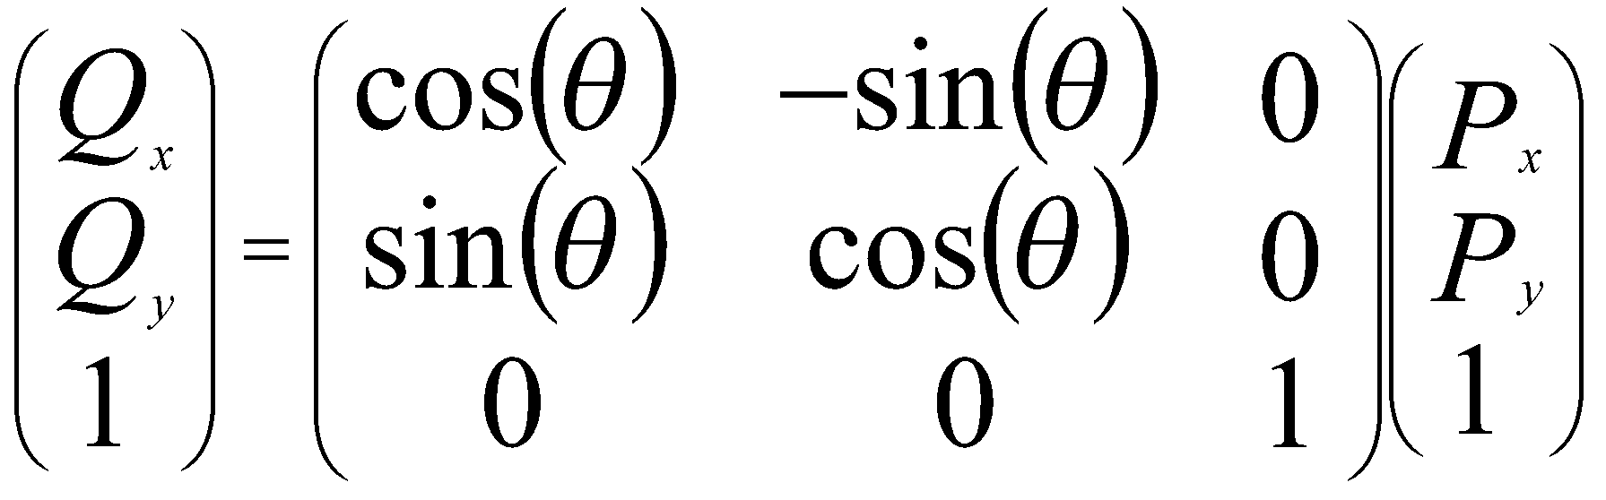
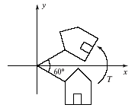
ROTATION
Clockwise around origin by angle θ:
28

Slide 29
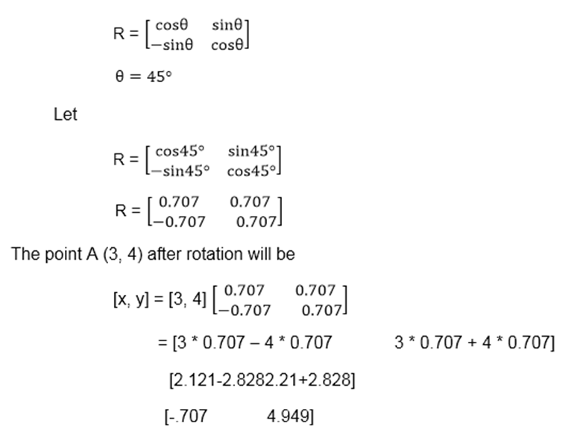
Example2: Rotate a line CD whose endpoints are (3, 4) and (12, 15) about origin through a 45° anticlockwise direction.
Solution: The point C (3, 4)

Slide 30
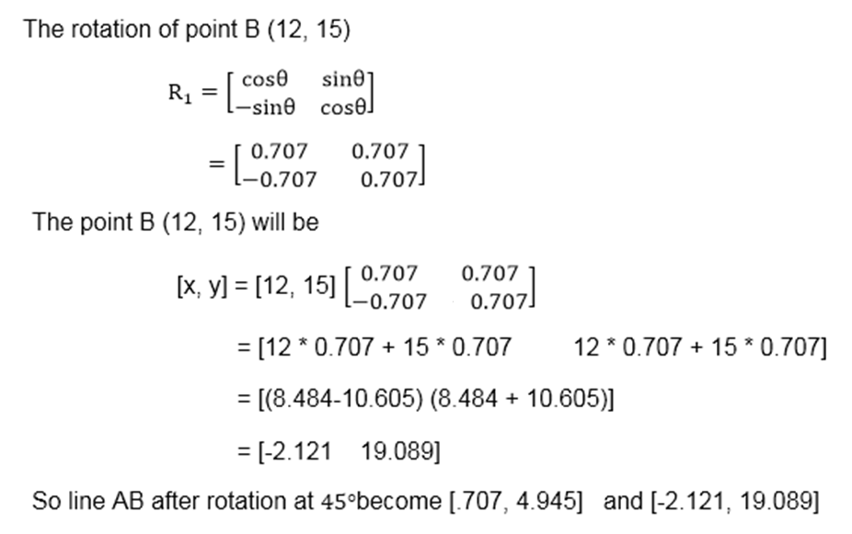

Slide 31
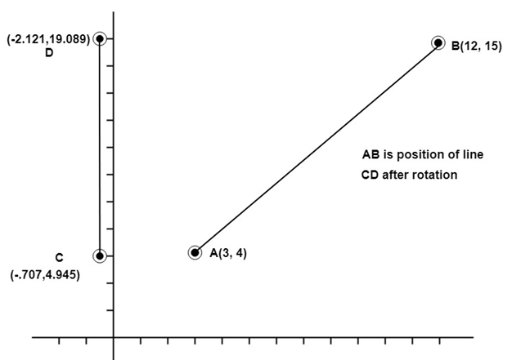

Slide 32
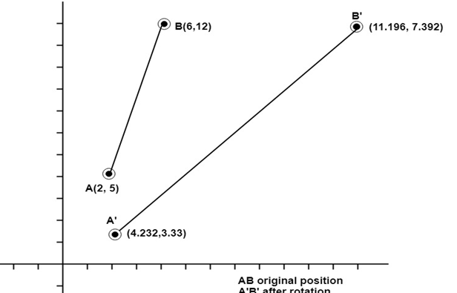
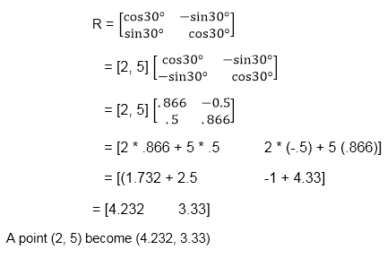
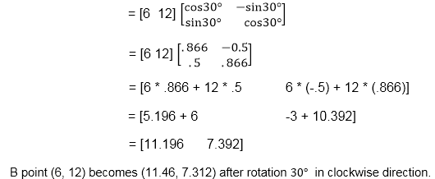
Step1: Rotation of point A (2, 5). Take angle 30°
Step2: Rotation of point B (6, 12)
Example3: Rotate line AB whose endpoints are A (2, 5) and B (6, 12) about origin through a 30° clockwise direction.

Slide 33
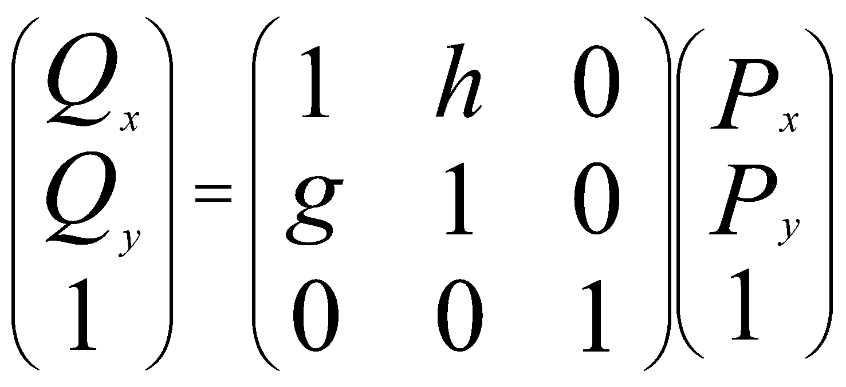
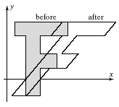
SHEAR
Shear H about origin: x depends linearly on y in the figure.
for example, italic letters).
33

Slide 34
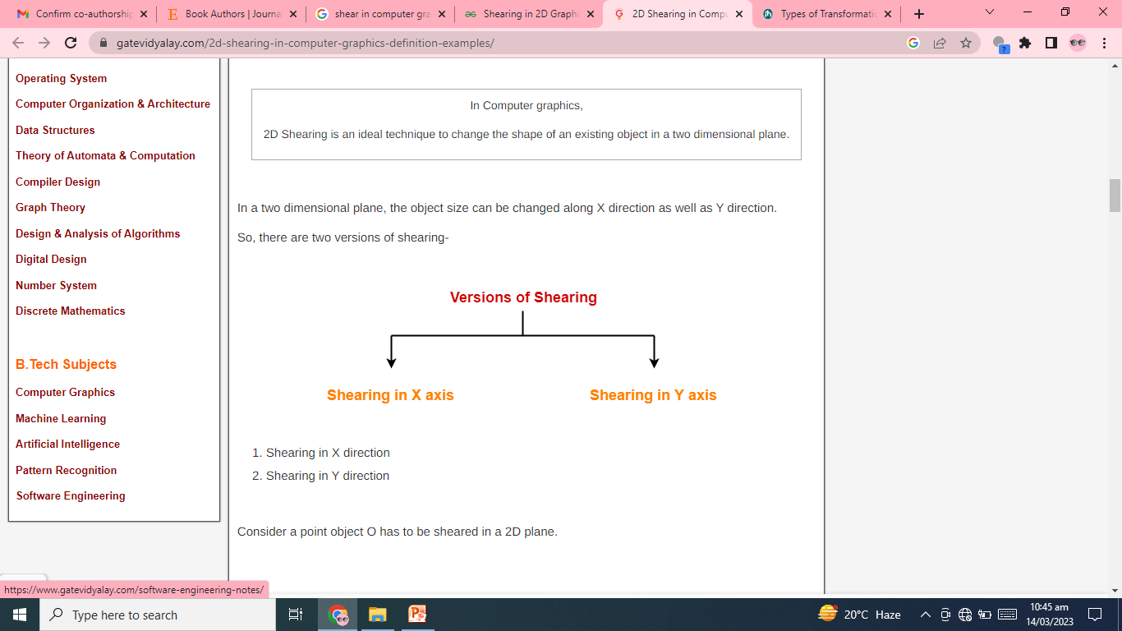

Slide 35
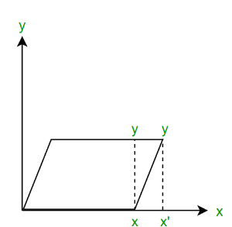
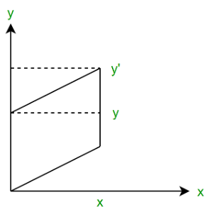
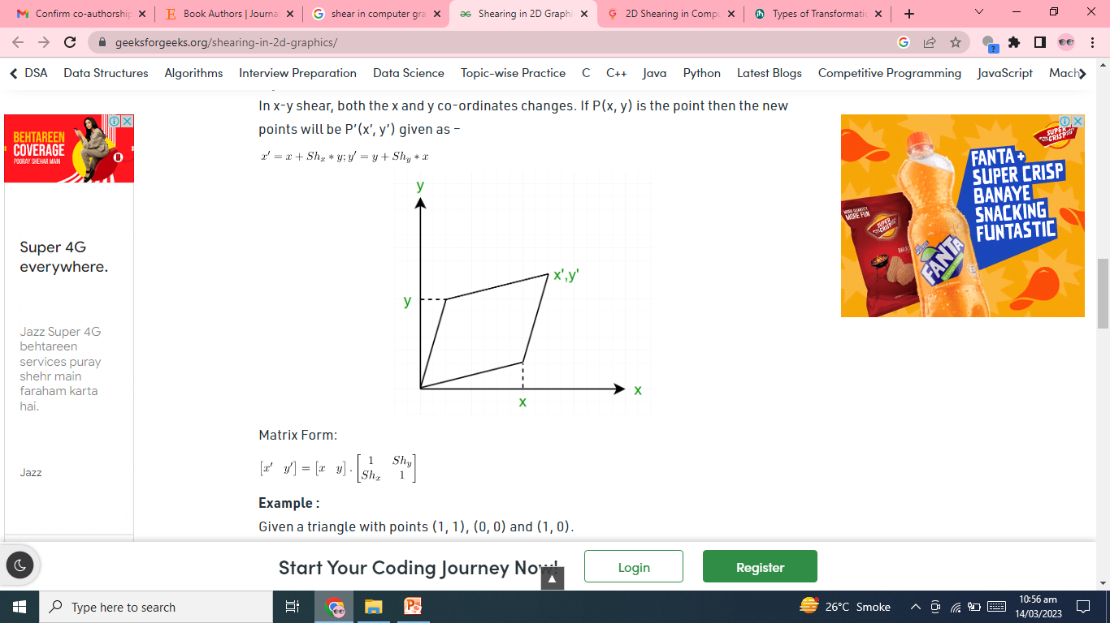

Slide 36
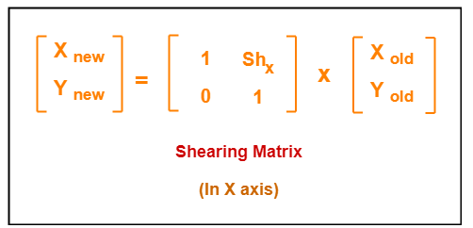
Shearing in X Axis-
Shearing in X axis is achieved by using the following shearing equations-
X_{new} = X_{old} + Sh_{x} x Y_{old}
Y_{new} = Y_{old}

Slide 37
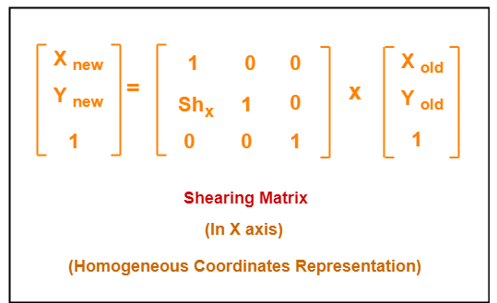

Slide 38
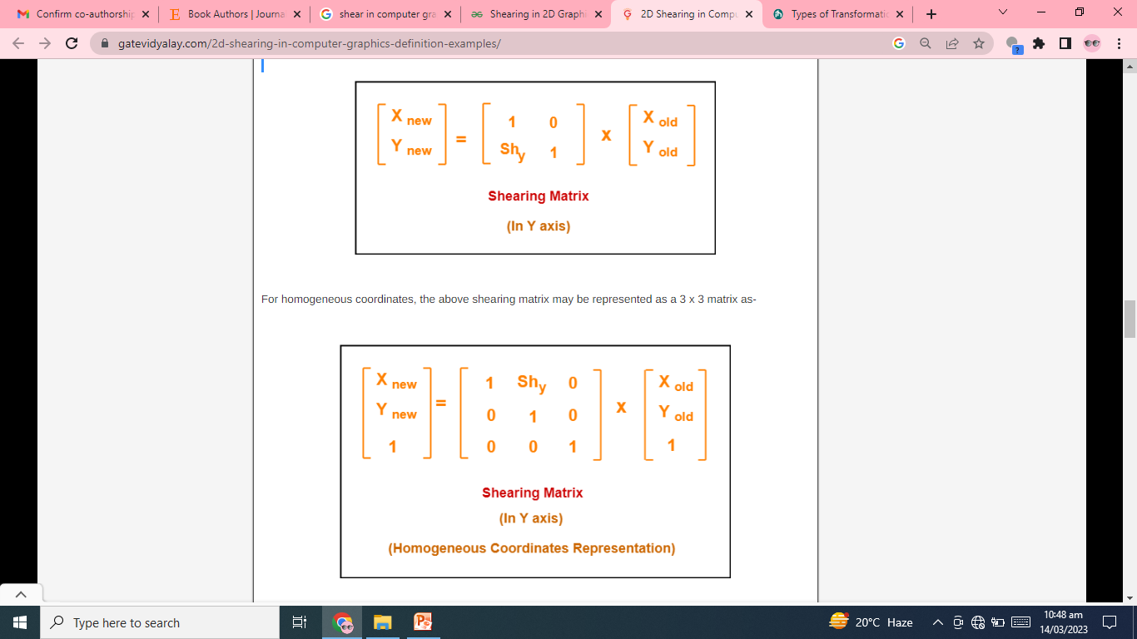
Shearing in Y Axis-
Shearing in Y axis is achieved by using the following shearing equations-
X_{new} = X_{old}
Y_{new} = Y_{old} + Sh_{y} x X_{old}
In Matrix form, the above shearing equations may be represented as-

Slide 40
Problem-01:
Given a triangle with points (1, 1), (0, 0) and (1, 0). Apply shear parameter 2 on X axis and 2 on Y axis and find out the new coordinates of the object.
Solution-
Old corner coordinates of the triangle = A (1, 1), B(0, 0), C(1, 0)
Shearing parameter towards X direction (Sh_{x}) = 2
Shearing parameter towards Y direction (Sh_{y}) = 2
Shearing in X Axis-
For Coordinates A(1, 1)
Let the new coordinates of corner A after shearing = (X_{new}, Y_{new}).
Applying the shearing equations, we have-
X_{new} = X_{old} + Sh_{x} x Y_{old} = 1 + 2 x 1 = 3
Y_{new} = Y_{old} = 1
Thus, New coordinates of corner A after shearing = (3, 1).

Slide 41
For Coordinates B(0, 0)
Let the new coordinates of corner B after shearing = (X_{new}, Y_{new}).
Applying the shearing equations, we have-
X_{new} = X_{old} + Sh_{x} x Y_{old} = 0 + 2 x 0 = 0
Y_{new} = Y_{old} = 0
Thus, New coordinates of corner B after shearing = (0, 0).
For Coordinates C(1, 0)
Let the new coordinates of corner C after shearing = (X_{new}, Y_{new}).
Applying the shearing equations, we have-
X_{new} = X_{old} + Sh_{x} x Y_{old} = 1 + 2 x 0 = 1
Y_{new} = Y_{old} = 0
Thus, New coordinates of corner C after shearing = (1, 0).
Thus, New coordinates of the triangle after shearing in X axis = A (3, 1), B(0, 0), C(1, 0).

Slide 42
Shearing in Y Axis-
For Coordinates A(1, 1)
Let the new coordinates of corner A after shearing = (X_{new}, Y_{new}).
Applying the shearing equations, we have-
X_{new} = X_{old} = 1
Y_{new} = Y_{old} + Sh_{y} x X_{old} = 1 + 2 x 1 = 3
Thus, New coordinates of corner A after shearing = (1, 3).
For Coordinates B(0, 0)
Let the new coordinates of corner B after shearing = (X_{new}, Y_{new}).
X_{new} = X_{old} = 0
Y_{new} = Y_{old} + Sh_{y} x X_{old} = 0 + 2 x 0 = 0
Thus, New coordinates of corner B after shearing = (0, 0).
For Coordinates C(1, 0)
Let the new coordinates of corner C after shearing = (X_{new}, Y_{new}).
Applying the shearing equations, we have-
X_{new} = X_{old} = 1
Y_{new} = Y_{old} + Sh_{y} x X_{old} = 0 + 2 x 1 = 2
Thus, New coordinates of corner C after shearing = (1, 2).
Thus, New coordinates of the triangle after shearing in Y axis = A (1, 3), B(0, 0), C(1, 2).

Slide 43
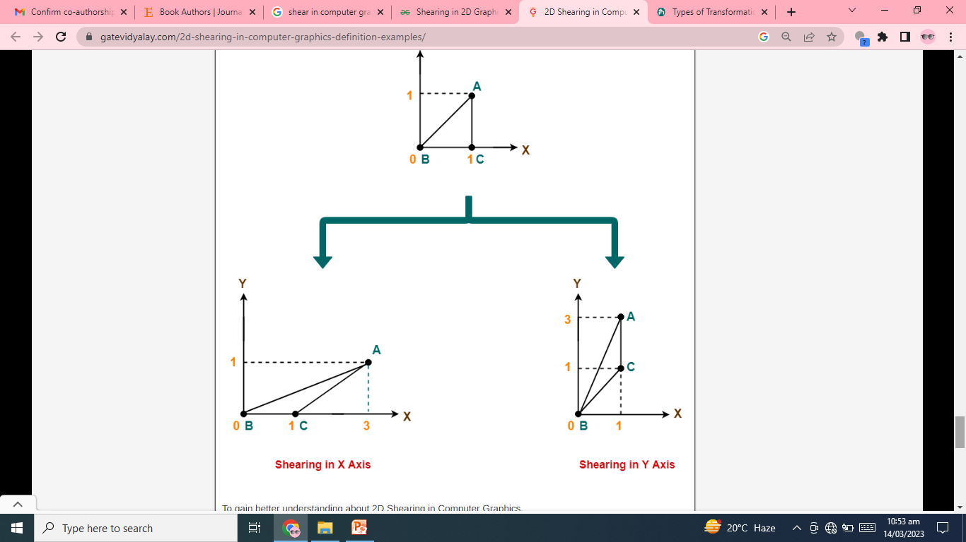

Slide 44
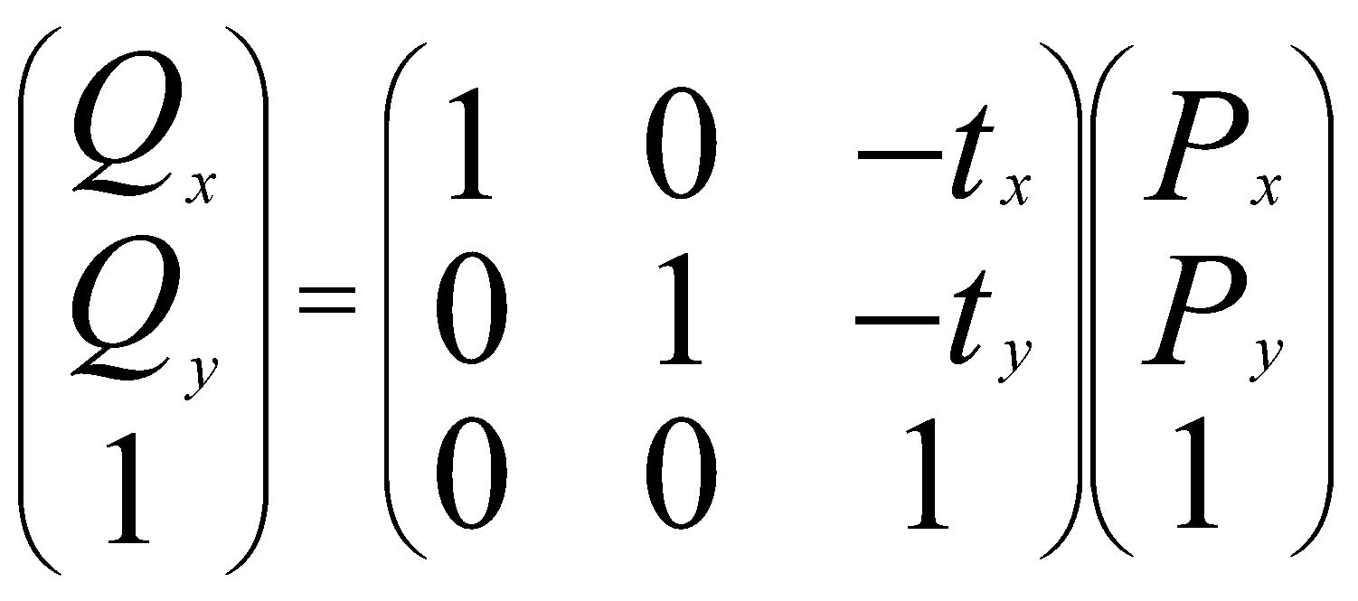
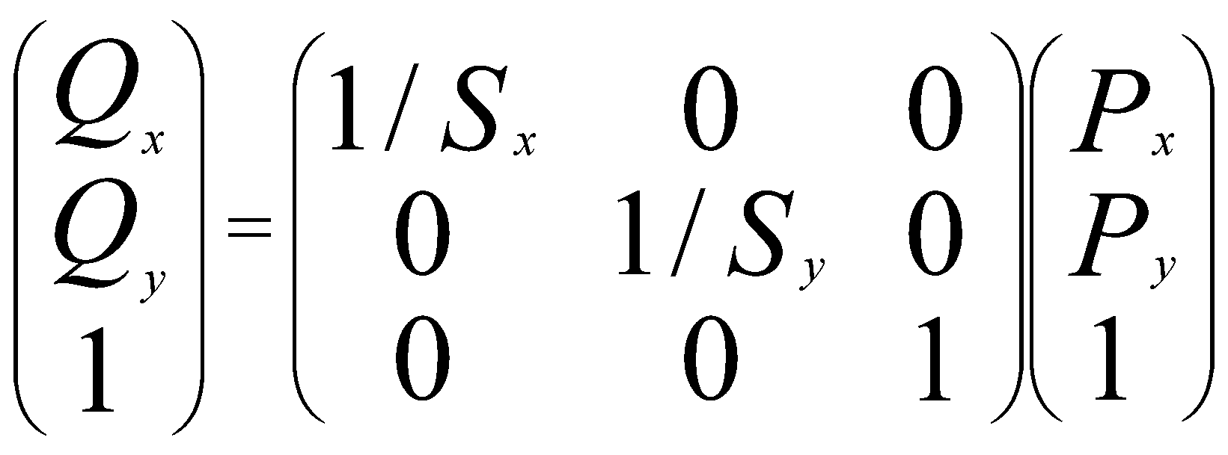
INVERSE TRANSLATION AND SCALING
Inverse of translation T⁻¹:
Inverse of scaling S⁻¹:
44

Slide 45
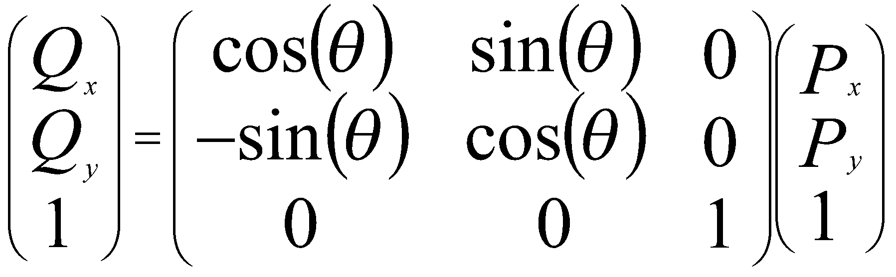
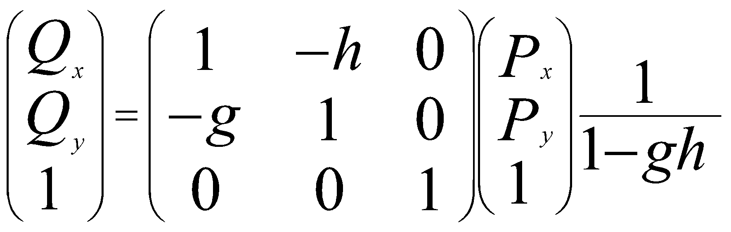
INVERSE ROTATION AND SHEAR
Inverse of rotation R⁻¹ = R(-θ):
Inverse of shear H⁻¹: generally h=0 or g=0.
45

Slide 46
COMPOSING AFFINE TRANSFORMATIONS
Usually, we want to apply several affine transformations in a particular order to the figures in a scene: for example,
translate by (3, - 4)
then rotate by 30º
then scale by (2, - 1) and so on.
Applying successive affine transformations is called composing affine transformations.
46

